Slide 1
Delivery Time and Supply of Fresh Fruits and Vegetables
Ankit Khandelwal (Management, IABM Bikaner)
Damini Thakur (Agriculture, CSKHPKV, Palampur)
Akshay Kaundal (Management, IABM Bikaner)
Amit Thakur (Agriculture, CSKHPKV, Palampur)

Slide 2
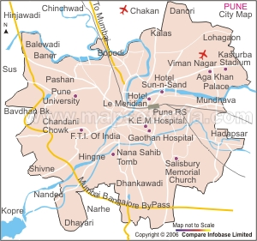

Target Area

Slide 3
Supply Chain
Local Residents
Farmers
Fresh produce
On priority basis
Hub
Remaining
Hotels/Dhabas/Processing
Remaining demand
Pune Mandi

Slide 4
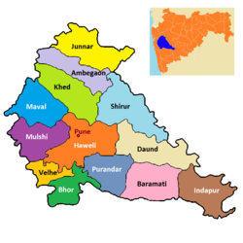

Procurement Route
92km, major vegetables
75.8km, vegetables
83.6km, vegetables
123.7km, Fruits & Vegetables

Slide 5










Price Spread Along the Value Chain
Commodity : Tomato
Market: Narayangaon, Maharashstra
G&P&L = $₹$2.30(8.3%)
Transporting, unloading = $₹$3.00(10.9%)
Wastage Margin = $₹4.1$(15%)
Gross Margin = $₹$11.1
₹48
Consumer
Wholesaler’s Margin
$$₹46$$
Trader’s Margin
$₹9$.00
$$₹3.81$$
$₹$0.34
Retailers Margin
Transportation, unloading at APMC
$₹$2.54
$₹$1.75
Market fee@1.05%
Farm Gate Price
$₹$1.25
$₹$2.30
Commission @5%
$$₹25$$
25+10%
Grading, Packing, Loading

Slide 6

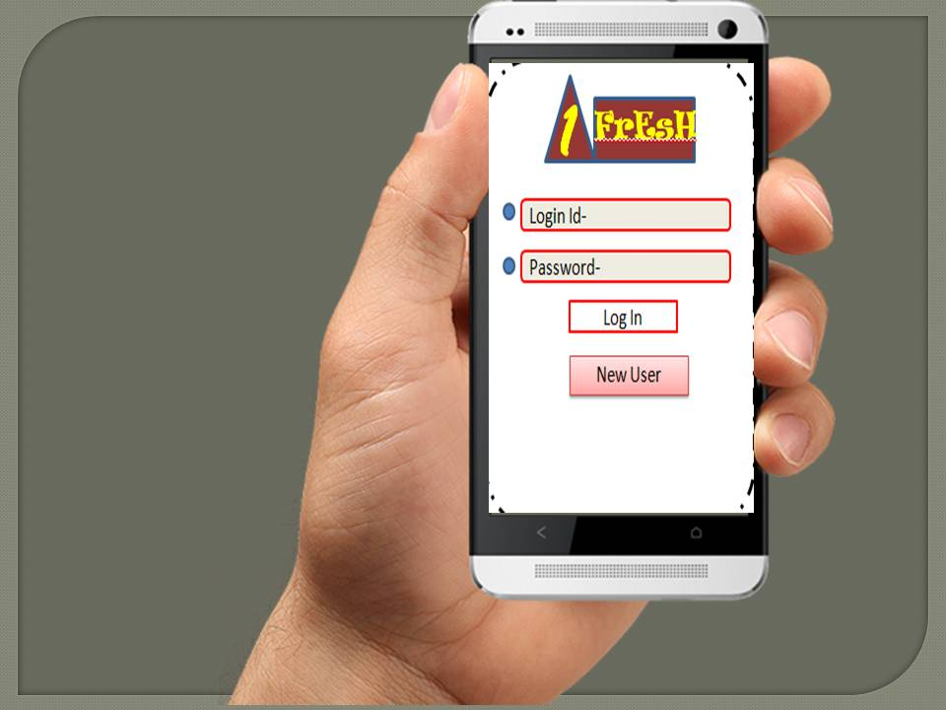

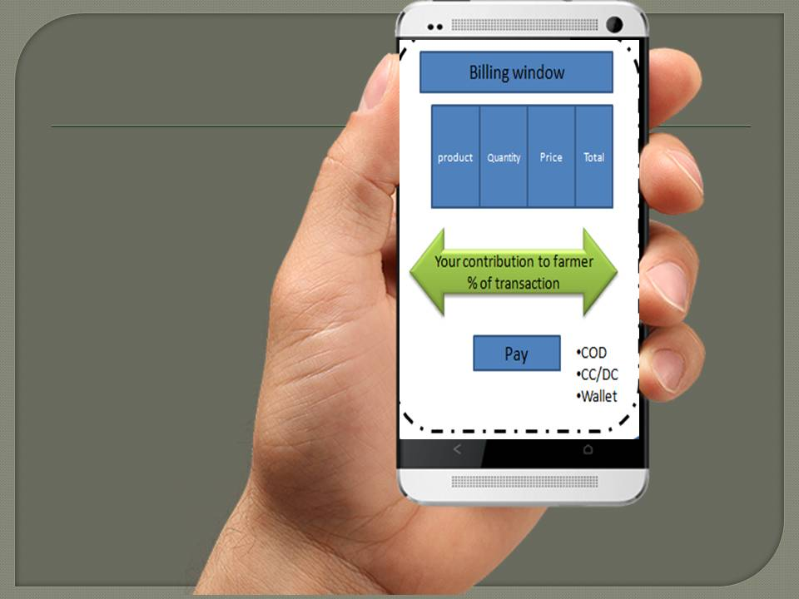
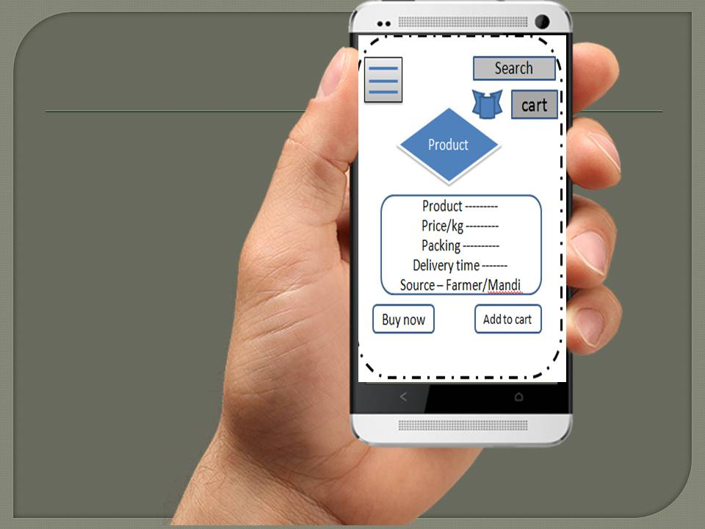

Slide 7
Thank you
“Let’s take a step towards the farmers' prosperity”

